Slide 1



Spring Cloud: Circuit Breaker - Hystrix Audience: Developer

Slide 2
Introduction
Spring Cloud: Circuit Breaker - Hystrix
Who I am: <Instructor Name>
Title
Organization
Role
Background

Slide 3
Agenda
Spring Cloud: Circuit Breaker - Hystrix
Microservices – History, Driving Forces, and Definition
Microservices Patterns
DevOps
Reactive Microservices
1
5
9
13
AD
All
D
AD
A
Microservices Prerequisites
Integration
Securing Microservices
Testing
2
6
10
14
AD
AD
A
D
A
A
Spring Boot
Migrating Monoliths to Microservices
Domain Driven Design Testing
Scaling Microservices
3
7
11
15
AD
D
A
A
A
Case Study
Cloud
UI
Microservices Anti-Patterns
4
8
12
16
AD
AD
All
All
A
A
Legend: All Developer Advanced Developer Architect
All
D
AD
A

Slide 4

Objectives
Spring Cloud: Circuit Breaker - Hystrix
At the end of this training, you should be able to:
Understand how software circuit breakers protect against cascade failure
Use Spring Cloud Netflix Hystrix annotations within your software to implement circuit breakers
Establish simple monitoring of Circuit Breakers using Hystrix Dashboard and Turbine

Slide 5
Topics
Spring Cloud: Circuit Breaker - Hystrix
Circuit Breaker Pattern
Netflix Hystrix Circuit Breaker
Hystrix Dashboards
Turbine

Slide 6
Cascading Failures and the Circuit Breaker Solution

Slide 7
Faults versus Failures
Spring Cloud: Circuit Breaker - Hystrix
Faults
Individual failures of individual services
Failure
Refers to the whole system
Goal
Prevent system failure in the face of inevitable faults
Source: http://www.javaworld.com/article/2927920/cloud-computing/build-self-healing-distributed-systems-with-spring-cloud.html

Slide 8
The Problem: Cascading Failure
Spring Cloud: Circuit Breaker - Hystrix
Having a large number of services as dependencies can lead to a 'cascading failures'
Without mitigating this, Microservices are a recipe for certain disaster!
X
X
X
X
X
X
What happens if
This service fails?
Notes:
So first, let's explore something known as a cascade failure.
Whenever you have a large number of interdependent services, there is always a possibility that one of them could be in a failed state; for any number of reasons: an unforseen runtime error, out of memory, we pushed a bad version of the code, it is overrun by too many simultaneous requests, etc. etc. In fact if you have 600 microservices as in the Netflix example, you can depend on at least one in a failed state a good portion of the time.
The issue is the affect that individual failures have on other services. In this illustration you can see that a single failure in a single service affects all of its clients, and their clients are affected, and so forth and so on. And the result of this is a ripple affect throughout our cluster of services, inevitably leading to visible problems in our user-facing interfaces.
A microservices architecture is vulnerable to this type of cascade failure. And if we are not proactive in addressing this we can count on a lot of trouble.

Slide 9
Distributed Systems – More Failure Opportunities
Spring Cloud: Circuit Breaker - Hystrix
Distributed systems → more opportunity for failure
Remember the fallacies of Distributed Computing
The Math: Assume 99.95% Uptime (Amazon EC2 SLA)
Single app – 22 minutes down per month
30 interrelated services – 11 hours downtime per month (bad)
100 interrelated services – 36 hours downtime per month (ouch!)
Notes:
Now to be fair a Monolithic application can have a failure of a single component cause a ripple effect across the application, but we are far more vulnerable to this in a distributed system. Recall the fallacies of distributed computing – in addition to our software failing we could have slow network, a node could drop out and be unreachable, a security policy could change and we can suddenly not be able to reach a node, and so on.
Another way to look at this is to take a look at a typical infrastructure SLA, like this one offered by Amazon Web Services. At present, if you spin up an instance in EC2, they guarantee a 99.95% uptime. That means if you project this across an entire month you are guaranteed no more than 22 minutes of downtime a month. (Technically you could have more downtime than this because of the way Amazon calculates downtime, but for our purposes this is fine) And you can imagine that a monolithic application like Etsy.com is well protected by simply running multiple instances behind a load balancer.
But if you have 30 interrelated services, and a failure in any one of them would cause a systemic failure of some kind, then we are looking at 11 hours of downtime per month, which is half a day. Perhaps your busiest day.
Going further, 100 interrelated services could result in as much as 36 hours of downtime per month. Over a day – perhaps your busiest day.
Now the example here is somewhat contrived, not all failures would result in a complete outage, and the industry's current way of dealing with many failures would be to show an error page when the specific failure occurred, but I think the point is made: We have to take action to isolate failures to prevent cascade failures from resulting in significant outages for large %s of time.

Slide 10
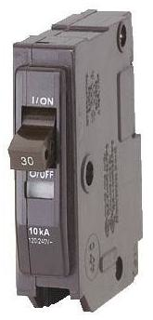
The Circuit Breaker Pattern
Spring Cloud: Circuit Breaker - Hystrix
Consider a household circuit breaker:
It ‘watches’ a circuit
When failure occurs (too much current flow), it ‘opens’ the circuit (disconnects the circuit)
Once problem is resolved, you can manually ‘close’ the breaker by flipping the switch
Prevents cascade failure, that is, your house burning down
Notes:
And this leads us to the “Circuit Breaker” pattern.
Think of a circuit breaker in a house (or car or boat or anything). What is it's purpose? Well in a house, it ensures only a certain amount of current can pass through a given circuit. If there is a failure – say by putting a toaster in a sink full of water – the breaker “trips” and “opens” the circuit preventing any electricity from flowing to that circuit at all. Now after this happens and you resolve the issue – say by unplugging the toaster – you can manually re”close” the circuit by flipping the switch on the breaker. The main point of the circuit breaker is to detect a failure condition and stop it from becoming much worse. And in doing so it prevents a cascade failure – like a fire in my house.

Slide 11
Using Spring Cloud Netflix Hystrix
Notes:
With this understanding of circuit breakers established, Let's talk about how to implement them with Hystrix

Slide 12

Hystrix – The Software Circuit Breaker
Spring Cloud: Circuit Breaker - Hystrix
Hystrix – Part of Netflix OSS
Light, easy-to-use wrapper provided by Spring Cloud
Detects failure conditions and “opens” to disallows further calls
Hystrix Default – 20 failures in 5 seconds
Identify “fallback” - what to do in case of a service dependency failure
Think: catch block, but more sophisticated
Fallbacks can be chained
Automatically “closes” itself after interval
Hystrix Default – 5 seconds
Notes:
Similar in concept to the circuit breakers used in your home, we can use circuit breaker constructs in our software, and that is exactly what Hystrix is. Hystrix is part of the Netflix OSS, and as such it is battle tested and is being used by Netflix in production right now as you watch this. Spring Cloud simply adds a lightweight, easy-to-use wrapper so Hystrix is as easy to use as adding a dependency and annotations.
Like a physical circuit breaker, Hystrix detects failure conditions. Let's say we are calling a service and we start to get repeated failures in a brief period of time. Hystrix responds by “opening” the circuit and not allowing further calls. The default is 20 failures over any 5 second window of time.
Now unlike a physical circuit breaker, we can define what we want to do when the primary service call is not available. For example we may resort to cached values or simply not display something to the user. You can think of this like a giant “catch” block, except this doesn't apply to individual calls but to all calls while the target service is unavailable. One interesting thing you can do here is have the fallbacks work in a chain.
Hystrix is designed to re-”close” itself after an interval to see if situations have improved. After all, sometimes the failure in a cloud environment is that a given service is simply overwhelmed with too many requests. By default it will “close” the circuit after 5 seconds.

Slide 13
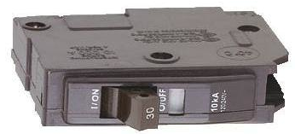
Comparison with Physical Circuit Breaker
Spring Cloud: Circuit Breaker - Hystrix
Closed when operating normally
Open when failure is detected
Failure definition flexible
Exception thrown or timeout exceeded over time period
Definable Fallback option
Automatically re-closes itself
Closed when operating normally
Open when failure is detected
Failure definition fixed
current flow exceeds amp rating
No fallback
Must be closed manually
Notes:
Here is a side-by-side comparison between the Hystrix circuit breaker and the physical breaker in your house.
First, be sure you have the terminology right. When everything in your house is operating normally we say that all of the circuit breakers are “closed”. And when a failure occurs and a breaker “trips”, we say the breaker is open. This terminology makes sense if you were looking at an electrical diagram, and the Hystrix circuit breaker uses the same closed=good, open=bad terminology, even though it may seem opposite.
Physical circuit breakers are designed to protect against one type of failure – excessive current flow. With Hystrix the definition is more flexible, but we are essentially looking for exceptions or timeouts occuring within a time interval. We're not looking at excessive flow, presumably that would manifest itself as a slowdown and timeout.
Now when physical circuit breakers are open, the circuit is disabled and that's it. With Hystrix, we have the option of defining fallback behavior. For example, let's say on our shopping application we have a recommender service, and it is suddenly unavailable, we could choose to display something else in the interim.
And finally, if one of the circuit breakers in your house trips, you have to manually diagnose the problem, go to the breaker box, and re-close the breaker. With Hystrix, the resetting is done automatically and is configurable, though a manual option is still available.

Slide 14
Please Understand…
Spring Cloud: Circuit Breaker - Hystrix
The Circuit Breaker pattern does not prevent errors.
The Circuit Breaker pattern does the following:
Mitigates the effects of errors
It detects and bypasses repeated errors of the same type
“Stops the bleeding”
Prevents systematic failures of the system
Does not “swallow” exceptions
Notes:
Now there is something you must realize about the circuit breaker pattern – it does not somehow stop all errors from occurring, it does not stop other services from experiencing the effect of such errors.
What it does is detect and bypasses large number of repeated errors from creating systemic failure. It stops the hemorrhaging to use a medical term. The original failure is still present, and still needs to be addressed. It is not intended as a way to hide or 'swallow' the exception – we don't want to do that, and if we did we could do it with a try catch block. We still need monitoring to detect failures.
A number of students have been puzzled on this point, especially when doing the lab – they expected zero errors to occur after an error scenario. The point is that after Hystrix throws the breaker, we shouldn't see the effects of the error.
A better name for the pattern might be the 'bulkhead' pattern. When there is a flood on a ship or a fire in a building, we want to close off the rest of the structure from the failure. The fire / flood is still there.

Slide 15
Hystrix (Spring Cloud) Setup
Spring Cloud: Circuit Breaker - Hystrix
Add the Dependency:
Enable Hystrix within a configuration class:
<dependency>
<groupId>org.springframework.cloud</groupId>
<artifactId>spring-cloud-starter-hystrix</artifactId>
</dependency>
@SpringBootApplication
@EnableHystrix
public class Application {
}
Notes:
Okay, enough theory. Let's see how this works in a real application.
First, you'll need to add the dependency for Spring Cloud Hystrix. Fortunately there is a starter for this, so as long as you have the Spring boot / Spring Cloud parents, you'll be all set.
Next, simply switch Hystrix on in one of your configuration classes.
At this point in the course, you should certainly be able to see the pattern here!

Slide 16
Hystrix (Spring Cloud) Example
Spring Cloud: Circuit Breaker - Hystrix
Use the @HystrixCommand to wrap methods in a circuit breaker.
Based on recent failures,
Hystrix will call
one of these two methods
@Component
public class StoreIntegration {
@HystrixCommand(fallbackMethod = "defaultStores")
public Object getStores(Map<String, Object> parameters) {
//do stuff that might fail
}
public Object defaultStores(Map<String, Object> parameters) {
return /* something useful */;
}
}
Notes:
Now here is an example of actual Hystrix use. This is an ordinary Spring bean, marked with a @Component annotation – of course any stereotype could be used here, or none at all, as long as it is instantiated as a Spring Bean.
Next, we have a getStores method as an example. Imagine the logic here makes an external call and is subject to failure. So we will mark it with a @HystrixCommand annotation. In this case, a fallback method is identified; it needs to have a matching signature in terms of parameters and return type.
When this code runs, depending on the state of the circuit breaker, one of these two methods will be executed. Hopefully the primary most of the time, but if the circuit breaker is open the fallback will be executed.
Now if we wanted to make it even MORE interesting, the “defaultStores” method itself could be annotated with @HystrixCommand, and it could indicate a tertiary fallback. There's no limit to the # of levels, though I think it would be rare to find too many real-world cases with more than one or two.

Slide 17
Custom Properties
Spring Cloud: Circuit Breaker - Hystrix
Failure / Recovery behavior highly customizeable
Use commandProperties and @HystrixProperty
Over 20% failure rate in 10 second period, open breaker
@HystrixCommand(
fallbackMethod = "defaultStores",
commandProperties = {
@HystrixProperty( name="circuitBreaker.errorThresholdPercentage", value="20"),
@HystrixProperty( name="circuitBreaker.sleepWindowInMilliseconds", value="1000")
})
public Object yourMethod( … ) {
// …
}
After 1 second, try closing breaker
Refer: Netflix Hystrix – Hystrix Javanica Configuration
Notes:
Hystrix allows us a good deal of fine-tuning regarding the failure detection and recovery behavior.
In this example, we've adjusted the error threshhold. This is similar to changing the amperage rating on a physical circuit breaker. In this case, if Hystrix detects a 20% failure rate over a 10 second “moving” window of time, it will trip the breaker
The next setting is about sleep. This refers to how long the breaker will stay open after being tripped. We have determined that a 5 second reset time is too leisurely, so we've set to a quicker 1 second response instead.
If you want to see all of the options that are available – and there are quite a few! – take a look at this link to Hystrix “Javanica”. Javanica is Netflix's Java library for Hystrix, and I think their documentation here is quite good, much better than what they've done in the Ribbon documentation for example.

Slide 18
Independence from Other Libraries
Spring Cloud: Circuit Breaker - Hystrix
Hystrix can be used independently from the other Netflix libraries
All of the Nexflix libraries can be used independently
But Hystrix (arguably) has more uses outside of a Cloud/Microservice environment
Notes:
One thought about Hystrix – it can be used independently from Eureka, Ribbon, Feign and the rest.
Actually, you can use all of these services independently of one another. But you may find that Hystrix has a very broad set of possible uses. In these cases it is just a matter of bringing in the dependency without any of the rest of Spring Cloud Netflix.

Slide 19
Command can be called various ways.
Spring Cloud: Circuit Breaker - Hystrix
Synchronously
Call execute and block thread (default behavior)
Asynchronously
Call in a separate thread (queue), returning a future; deal with Future when you want
Just like Spring's @Async annotation
Reactively
Subscribe, get a listener (Observable)
Notes:
To make it more interesting, the HystrixCommand gives us some really nice options for how we want the target logic to be invoked.
The default is synchronous execution, the same as you were probably expecting. We execute the command, and when it is done we get control back. In the interim, we are blocking up one of our threads.
But we also have the option to fire the command in a separate thread. This is essentially the same as what I can do with Spring's @Async annotation, except adding the circuit breaker feature to it. This is an excellent way to improve throughput if I have multiple work items that do not necessarily need to run in sequential order. And it is really easy to implement too because all we need to do is have the method signature return a Java Future.
Even more interesting is the reactive model. This is asynchronous too, but even better because we don't need to query a Future object to see if it is done yet. We can have an Observable that will be executed as soon as the work is done, and therefore all we need to do is listen for the event.
Let's take a look at some examples.

Slide 20
Example: Asynchronous Command Execution
Spring Cloud: Circuit Breaker - Hystrix
Have method return Future
Wrap result in AsyncResult
@HystrixCommand( … )
public Future<Store> getStores(Map<String, Object> parameters) {
return new AsyncResult<Store>() {
@Override
public Store invoke() {
//do stuff that might fail
}
};
}
Notes:
Here is an example of an Asynchronous command execution via Hystrix.
Essentially, the only real difference is the return type. Any return type based on a Java Future tells Hystrix to invoke the method in a separate thread. The caller of this method gets the Future immediately, and has the option of checking the Future to see if it is done, and what the result is.
The only unusual part is the AsyncResult. Suffice it to say that the returned value needs to be wrapped in an AsyncResult to keep the compiler happy. The invocation takes place in another thread, managed by Hystrix.

Slide 21
Example: Reactive Command Execution
Spring Cloud: Circuit Breaker - Hystrix
Have method return Observable
Wrap result in ObservableResult
@HystrixCommand( … )
public Observable<Store> getStores(Map<String, Object> parameters) {
return new ObservableResult<Store>() {
@Override
public Store invoke() {
//do stuff that might fail
}
};
}
Notes:
And here is the Reactive model. Note that the returned value is some kind of Observable; this instructs Hystrix to use the reactive model for invocation. The caller of this code will get the observable, and can subscribe to it as a Listener. The listening code will be invoked automatically as soon as the call is complete.
Note that similar to the previous, the method needs to return an ObservableResult to make the compiler happy.

Slide 22
Hystrix Properties
Spring Cloud: Circuit Breaker - Hystrix
execution.isolation.thread.timeoutInMilliseconds
How long should we wait before considering this an error?
circuitBreaker.requestVolumeThreshold
Number of requests in rolling time window (10 seconds) that activate the circuit breaker (NOT the number of errors that will trip the breaker!)
circuitBreaker.errorThresholdPercentage
Percentage of failed requests that will trip the breaker (default = 50%)
metrics.rollingStats.timeInMilliseconds
Size of the rolling time window (default = 10 seconds)
Notes:
As mentioned, there are a number of useful properties that you can set to fine-tune the behavior. This is a short set of helpful ones.
A nice one off the bat is related to timeout. Sometimes our systems are sensitive to more than just failure, but slow performance. We may decide that if a target service's performance degrades beyond a certain point, we might as well consider it unavailable. Besides, perhaps the reason the target service is slow is because it is overwhelmed with work – opening the breaker will give it some breathing room.
The request volume threshold is tricky. This is describing the threshold beyond which we want the circuit breaker to be 'active'. This is not talking about a number of errors. For example, we could say that if we have less than 5 transactions within a 10 second period, we might not want the circuit breaker functionality to even be active, even if all 5 fail.
The errorThresholdPercentage is easier. This is setting the 'Amperage' of our breaker. If more than some % of attempts fail within a moving 10 second time window, the breaker should open. Default is 50% - we'll consider 50% a systemic failure.
Now I've mentioned a few times about a 10 second period, or 10 second “moving time window”. This window is configurable using this 'rollingStats' property. Essentially, Hystrix keeps track of the exact time when each failure occurred. When a new failure occurs, it adds it to the collection, throws out any events that happened before the threshold started, and checks the threshold.

Slide 23
How to Reset the Circuit Breaker?
Spring Cloud: Circuit Breaker - Hystrix
When the failing service is healthy, we want to 'close' the circuit breaker again
circuitBreaker.sleepWindowInMilliseconds
How long to wait before closing the breaker (default = 5 seconds)
circuitBreaker.forceClosed
Manually force the circuit breaker closed
Notes:
The Hystrix circuit breaker is designed to reset itself. After all, if the circuit breakers required manual interaction to reset them like the ones in our homes, and if we had hundreds of them throughout our codebase, we would have created a different kind of nightmare. Better to describe to Hystrix what policy we would like it to follow to automatically reset breakers.
The main item to control is how long we would like the breaker to stay open before Hystrix tries to close it again. This is controlled by the sleepWindow property here. You can also force the circuit breaker closed using the forceClosed property, but it is a bit difficult to think of a realistic case to use this property.

Slide 24
Monitoring with the Hystrix Dashboard and Turbine
Notes:
At this point you have enough knowledge to work through the exercise at the end of the module. But before we stop, I'd like to introduce to you some interesting monitoring options that you can use to keep an eye on the “circuits” in your systems so you can visually see that everything is running successfully.

Slide 25
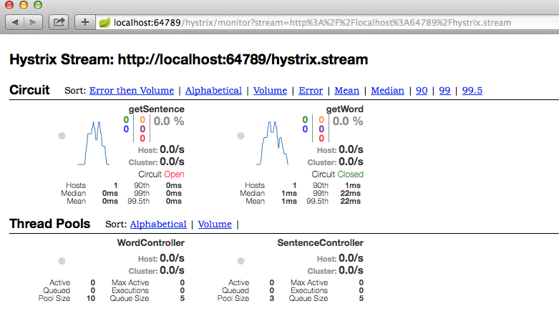
Hystrix Dashboard
Spring Cloud: Circuit Breaker - Hystrix
Hystrix provides a built-in dashboard to check the status of the circuit breakers.
Notes:
One thing that is important to consider in any microservice environment is the monitoring of the various services. One of the items we should really keep an eye on is our circuit breakers, and how often they are tripping, and why.
A really nice feature of Hystrix is the Hystrix Dashboard. This provides a nice web interface showing all the state of all the circuit breakers within an application. It takes a bit of time to get used to what the display is telling you, but in time you can see that it is giving you a LOT of insight into your application.

Slide 26
Hystrix Dashboard Setup
Spring Cloud: Circuit Breaker - Hystrix
Add the additional Dependency, include actuator:
Enable Hystrix Dashboard within a configuration class:
<dependency>
<groupId>org.springframework.cloud</groupId>
<artifactId>spring-cloud-starter-hystrix-dashboard</artifactId>
</dependency>
<dependency>
<groupId>org.springframework.boot</groupId>
<artifactId>spring-boot-starter-actuator</artifactId>
</dependency>
@SpringBootApplication
@EnableHystrix
@EnableHystrixDashboard
public class Application {
}
Notes:
To add the hystrix DASHBOARD to your application, you need only add the spring cloud dependency for the dashboard, and make sure that the spring boot actuator is also present.
To enable the dashboard, within your configuration class, IN ADDITION to any enable annotation you have for Hystrix itself, add the @EnableHystrixDashboard annotation.

Slide 27
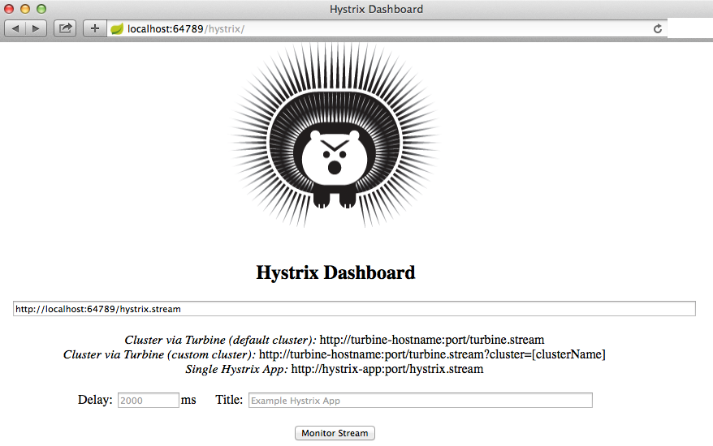
Accessing Hystrix Dashboard
Use URL http://<host>:<port>/hystrix
Spring Cloud: Circuit Breaker - Hystrix
Enter URL: http://<host>:<port>/hystrix.stream
Enter whatever title
you want to see
on the screen
Notes:
Accessing the Hystrix dashboard is actually a bit tricky. The easy part is to simply access the “/hystrix” endpoint on your service. You'll see the hystrix web page that you see here, which is not the actual monitor.
This page is prompting you to enter the Hystrix “stream” to be used to display the monitor. If you take a close look at the text, and temporarily ignoring anything related to “Turbine”, you can see it is looking for you to enter a URL of a “stream” - all of the hystrix enabled services will automatically emit this stream from the “hystrix.stream” endpoint. You can enter the URL of ANY of your services to monitor them. But to monitor this service itself, just copy the URL from your browser, paste it below, and add “.stream”. The “delay” is how often you want the screen to refresh, and the title is what you want to display on the top of the page. Just click “monitor stream”

Slide 28

The Hystrix Dashboard
Spring Cloud: Circuit Breaker - Hystrix
Each method annotated with @HystrixCommand appears on the dashboard.
“getSentence”
Is currently in a failed state
(breaker is open)
“getWord”
is healthy
(breaker is closed)
Notes:
...And the next thing you will see is the Hystrix dashboard. This web page is actively monitoring whatever stream you indicated earlier. In this example, I've pointed it to the “sentence” / “word” service we've been working with in this course, where the methods were annotated with @HystrixCommand as illustrated a few slides back.
Each method annotated with @HystrixCommand shows up here. For purposes of example, I deliberately caused a failure so you can see what an “open” breaker looks like – I made the sentence method fail by simply not starting some of the word services – AND not providing a fallback. You can see the getWord circuit is fine, of course, it isn't being called in my example.

Slide 29

Monitoring using Turbine
Spring Cloud: Circuit Breaker - Hystrix
Monitoring large numbers of Hystrix dashboards isn't really practical.
Turbine provides a consolidated view
Gathers metrics from the individual instances
Reviews
Checkout
Search
Cart
Payment
Shipping
Catalog
Inventory
Contact
Customer
Order
Turbine
Notes:
Now before we wrap up and do the lab let me introduce Turbine to you.
The hystrix dashboard I've just shown you is very nice, but if we have a large number of Microservices it isn't really practical to install and visit a dashboard for each one.
So the solution is Turbine. Turbine is simply a single Hystrix dashboard that listens to and aggregates the streams of all of the other Hystrix enabled services. It is fairly easy to setup – add dependency and @EnableTurbine, and it interacts with Eureka to find all of the client services. I won't provide an example here of Turbine, but you can take a look at the Spring Cloud reference to see how to set one up.

Slide 30
Lab
Wrap the call in the previous lab in @HystrixCommand and provide an appropriate fallback.
Test by shutting down target service.
Running the newly created project
Notes:
Here you can just run the project. Emphasize that it is just a Java “main” application.
It will simply load the Spring application context, then exit when it is apparent there is nothing else to do.
We will add to this later.

Slide 31

Q&A

Slide 32

Summary
Spring Cloud: Circuit Breaker - Hystrix
Summary
In this course, you learned about the following:
Software circuit breakers protect against cascade failure.
Spring Cloud Netflix Hystrix provides an easy way to add circuit breakers to your applications.
You can use Hystrix Dashboard and Turbine to monitor your circuit breakers.

